Slide 1
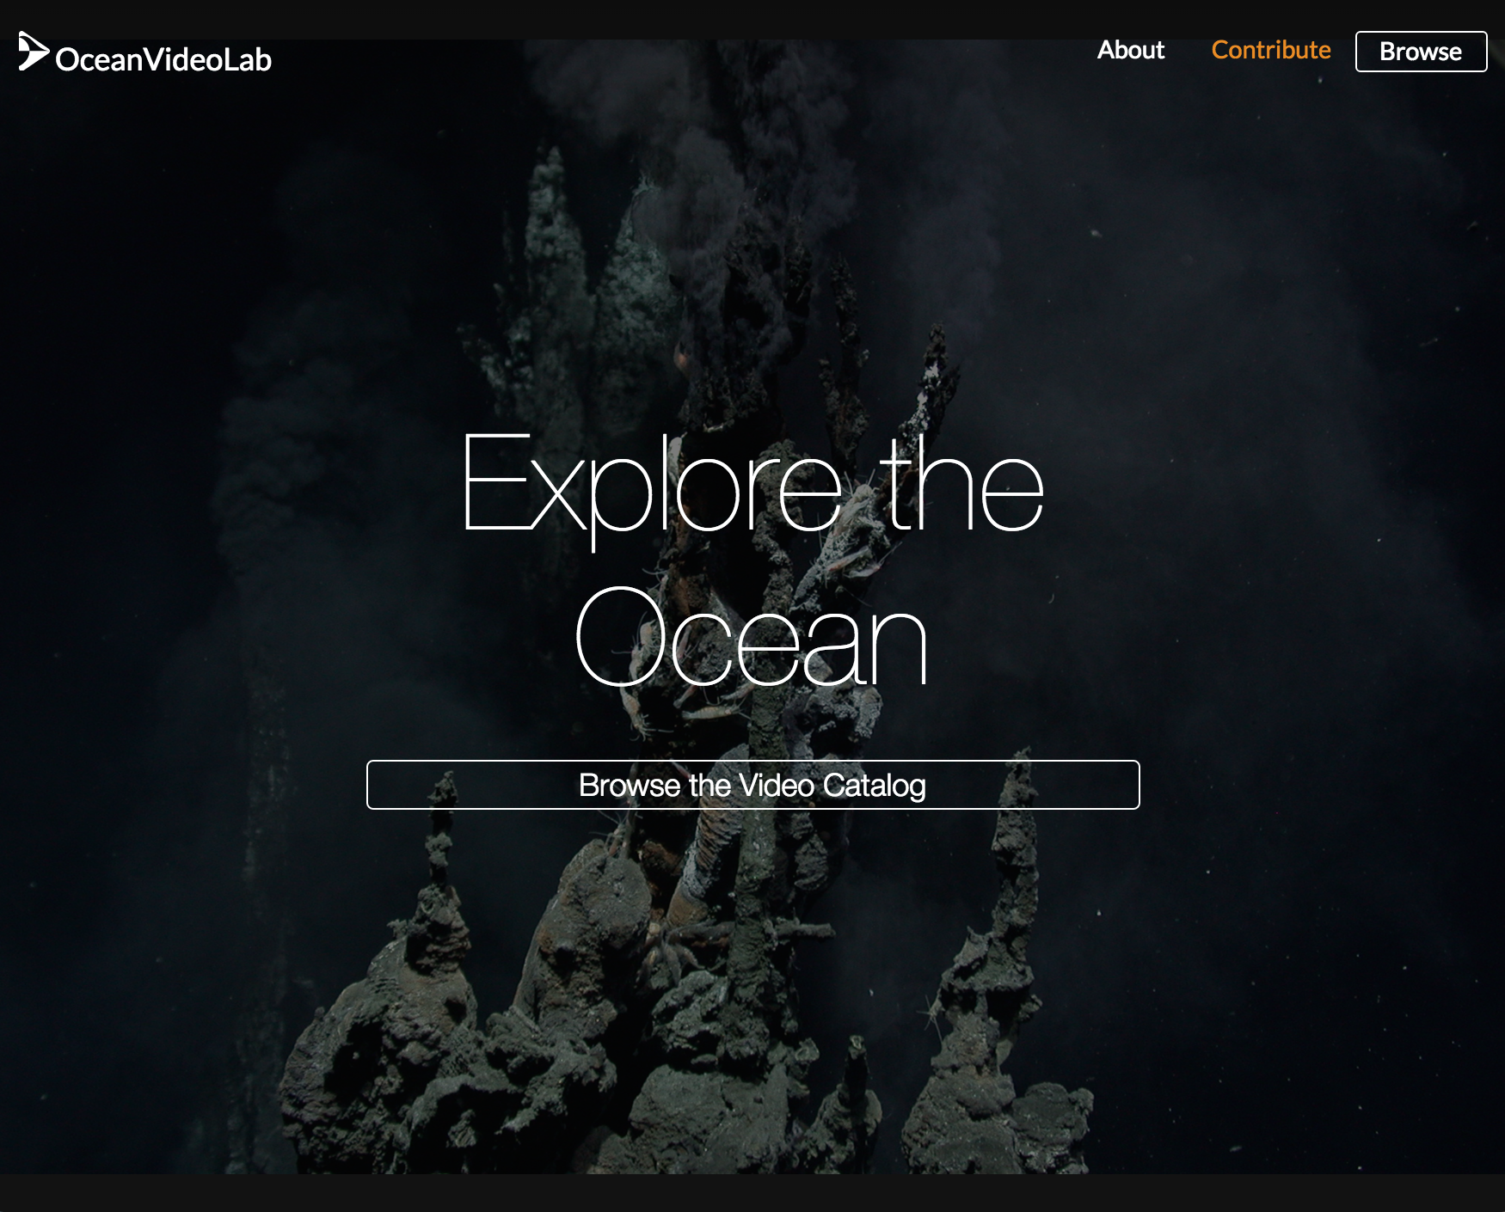
V. Ferrini & J. Morton (LDEO)
oceanvideolab.org

Slide 2


Motivation
Encourage public access to video via YouTube
Enable registration/annotation of any video content
Search across annotations from any video, by:
Annotation, location, date/time, water depth…
Integrate with other data (e.g. bathymetry)
Annotations accessible through services and exportable (XML, GeoJSON, ASCII, SHP, etc)

Slide 3
Input Requirements
Link to public YouTube video
Temporally continuous (no pause during recording)
Optional, but strongly encouraged
Start time
ASCII Navigation file
Additional metadata enables linking to, and integration with, other online data resources

Slide 4
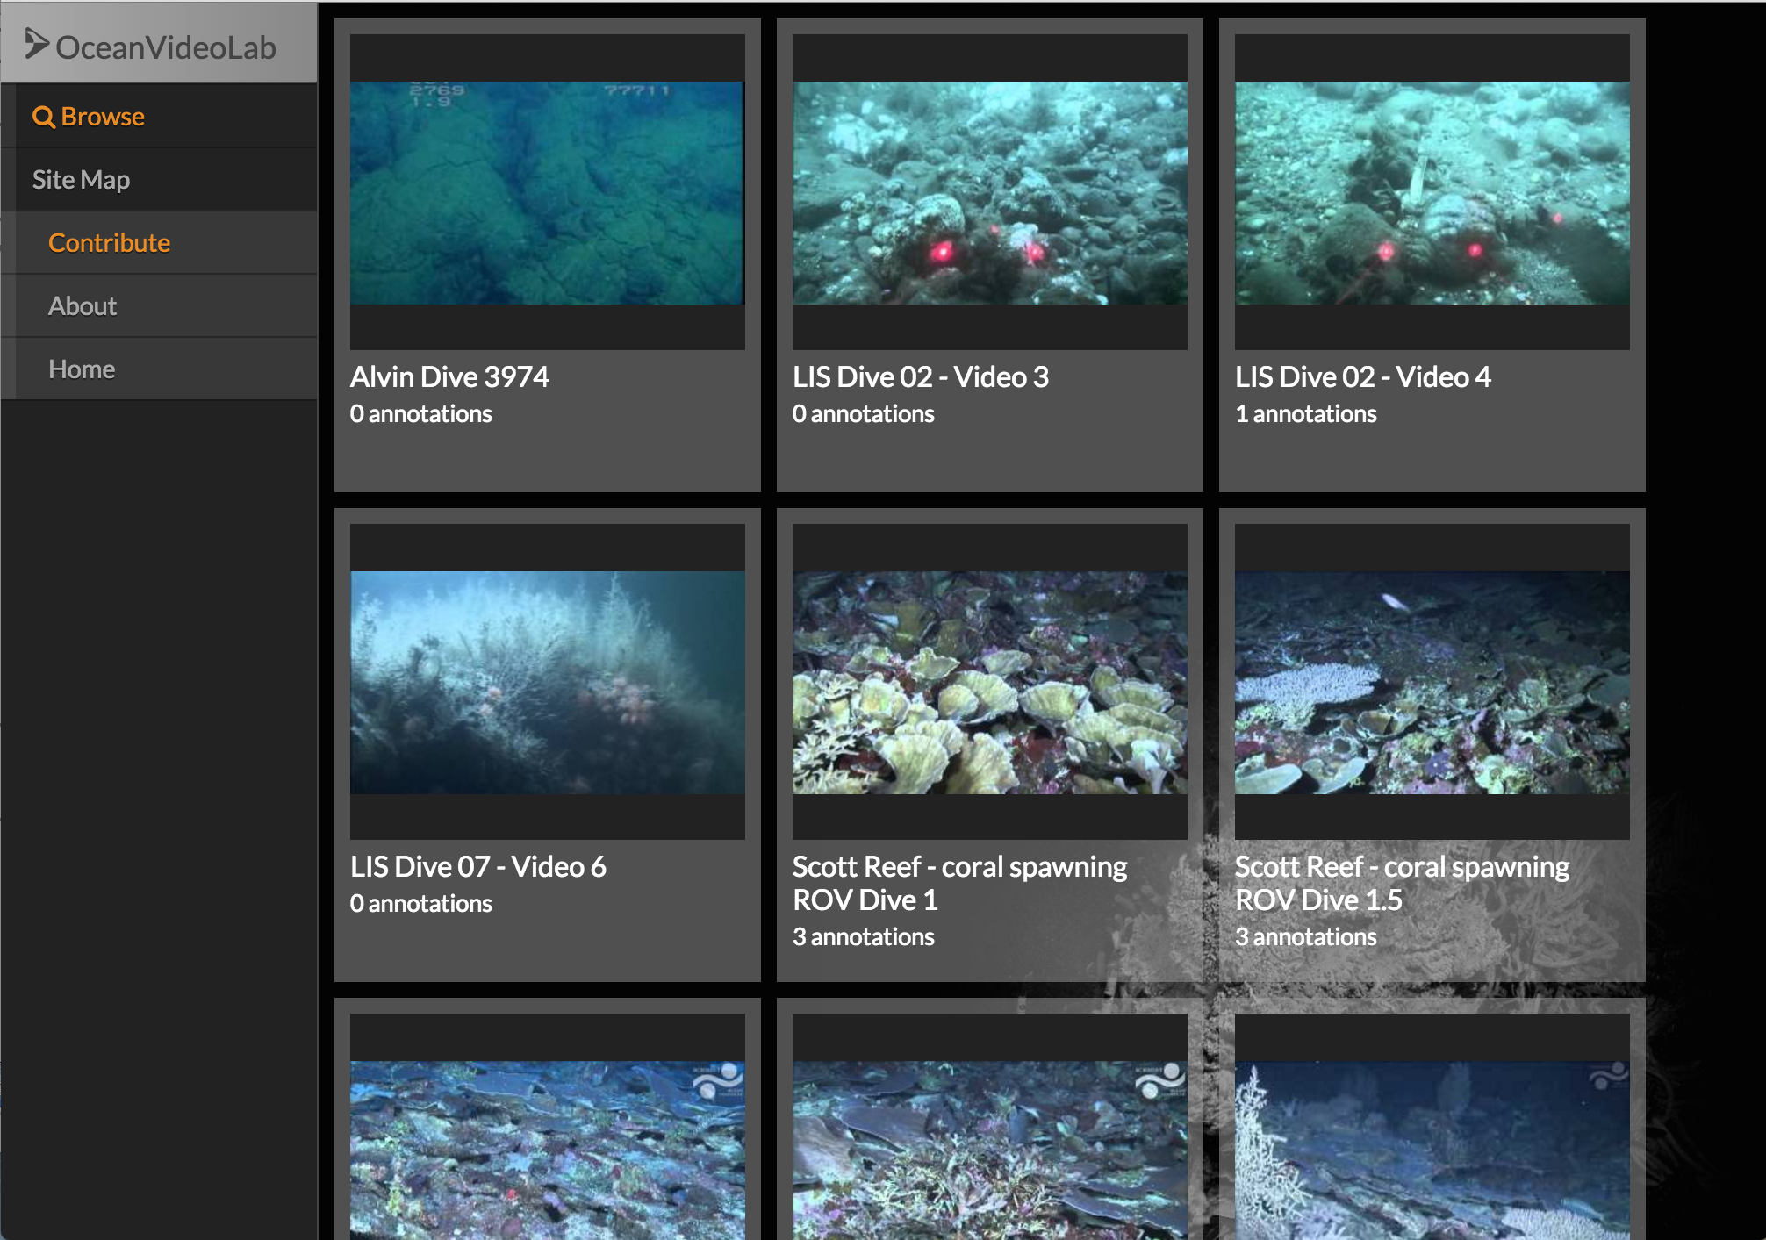
OVL – Video Browser

Slide 5
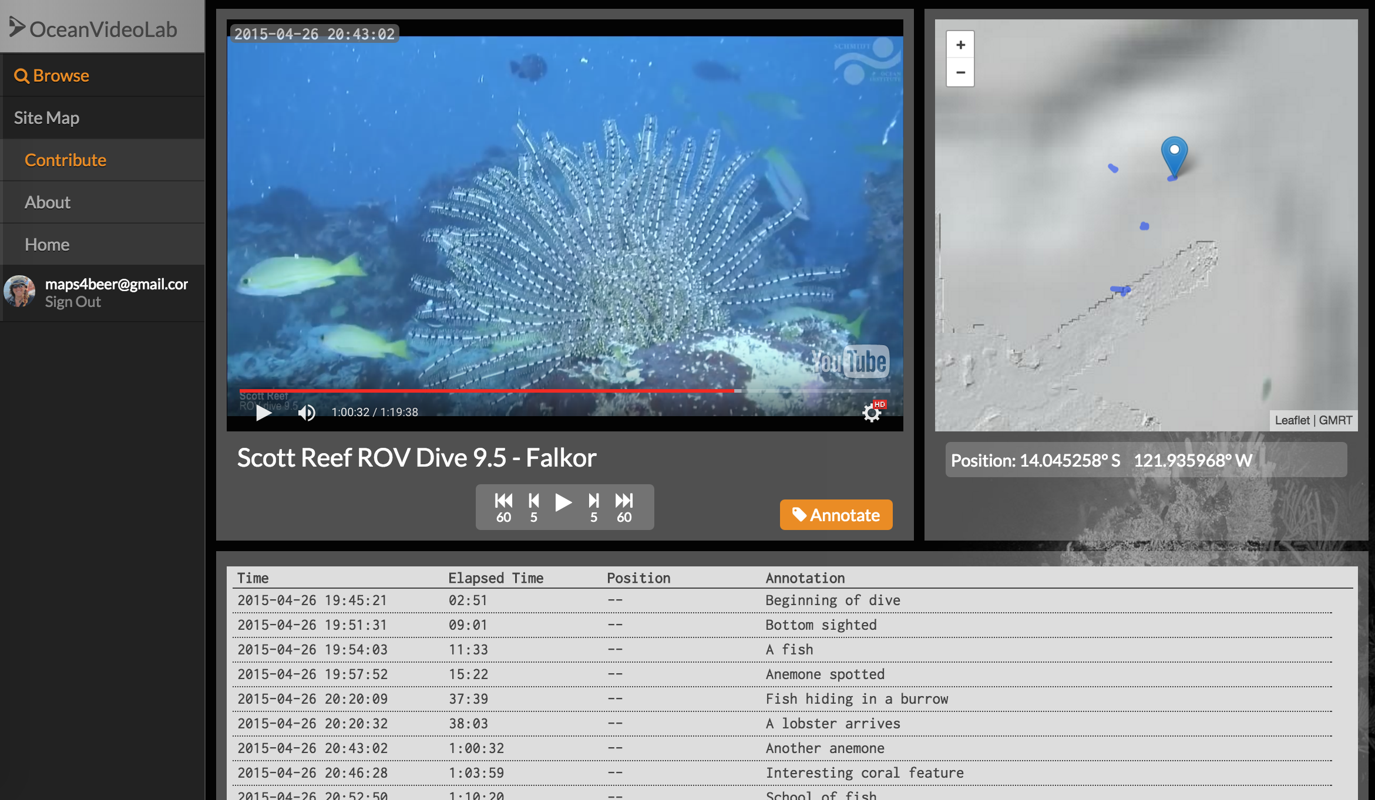
OVL – Video Player

Slide 6
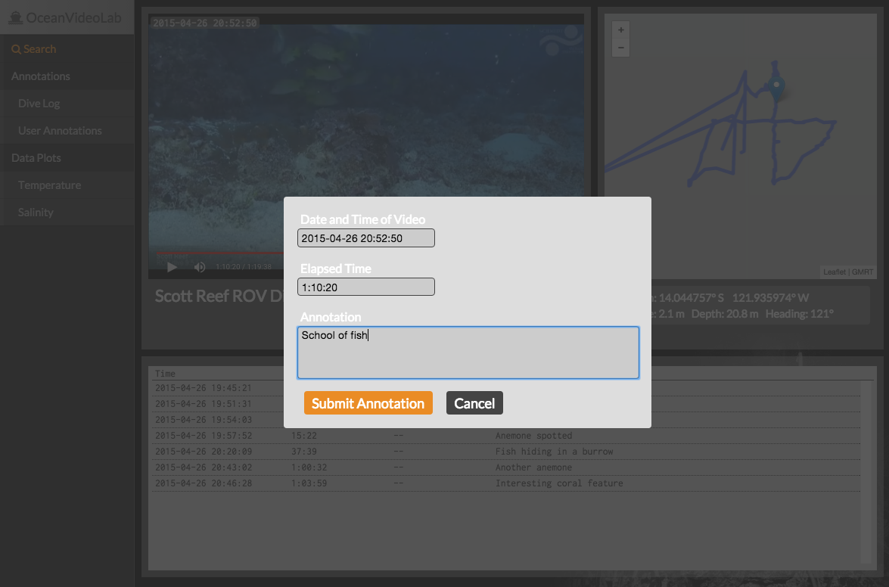
OVL – Annotation

Slide 7
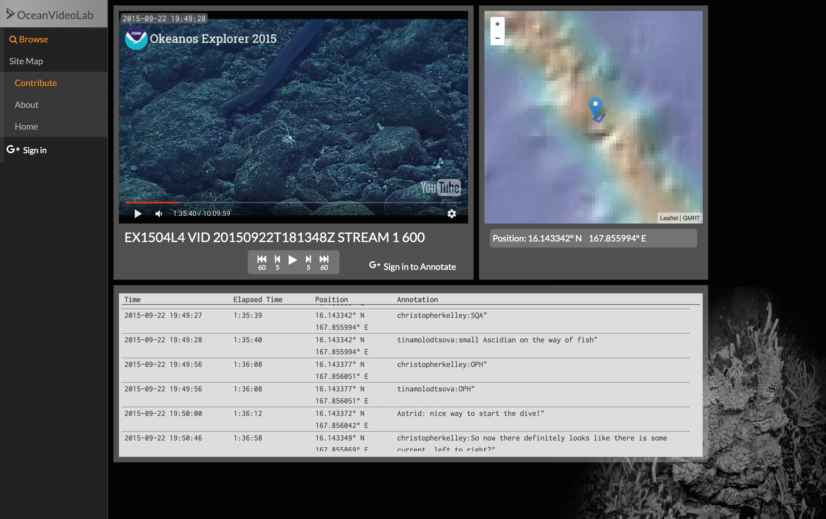
Import Text Events & Associate with Nav

Slide 8
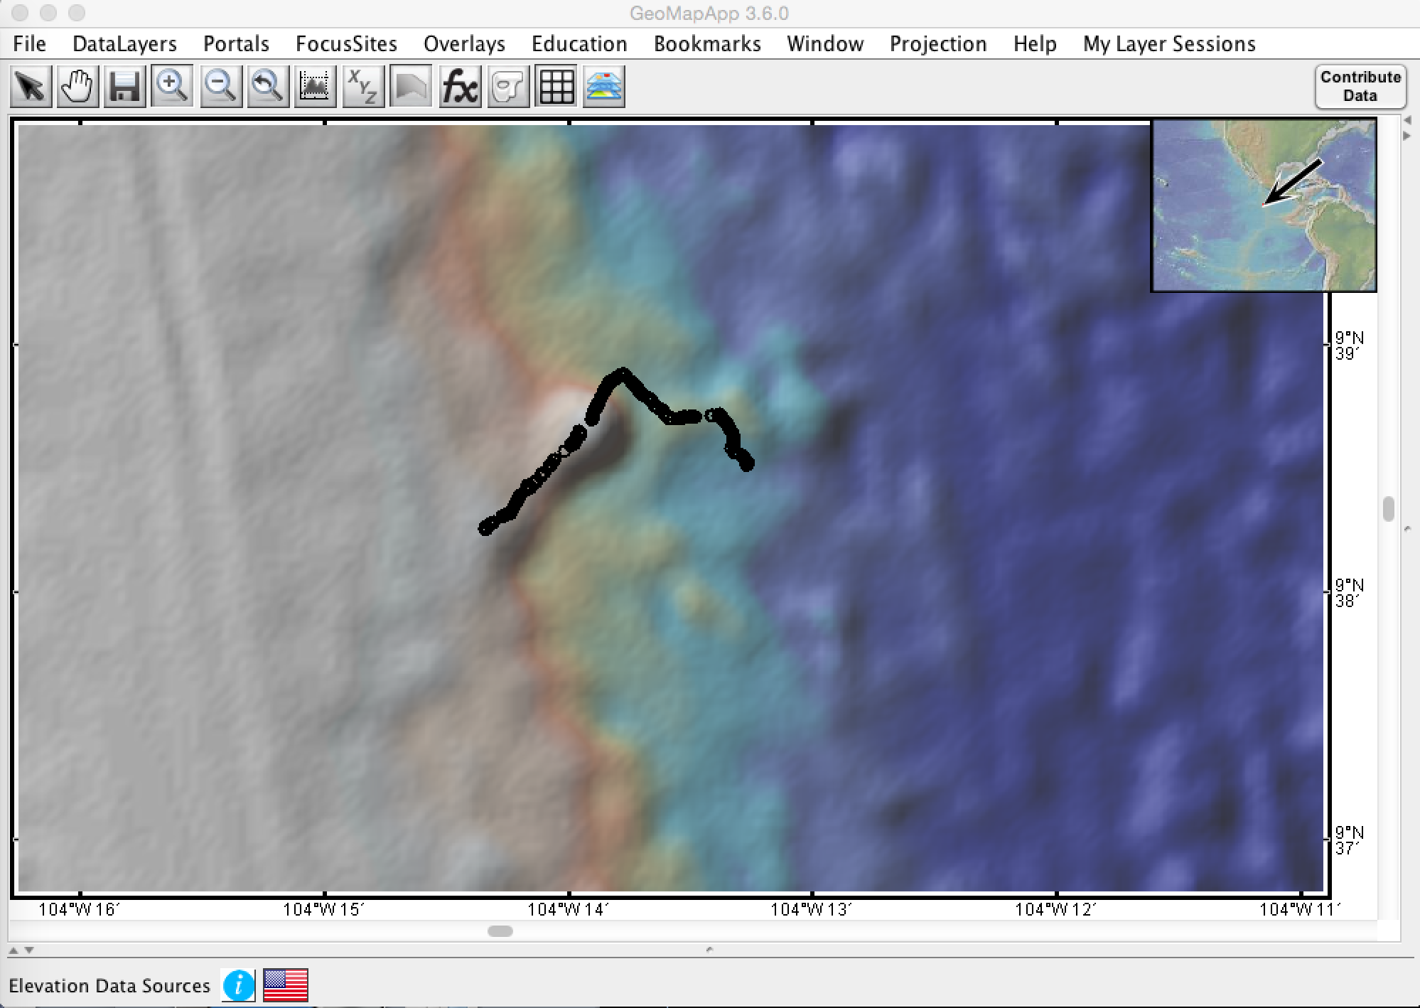
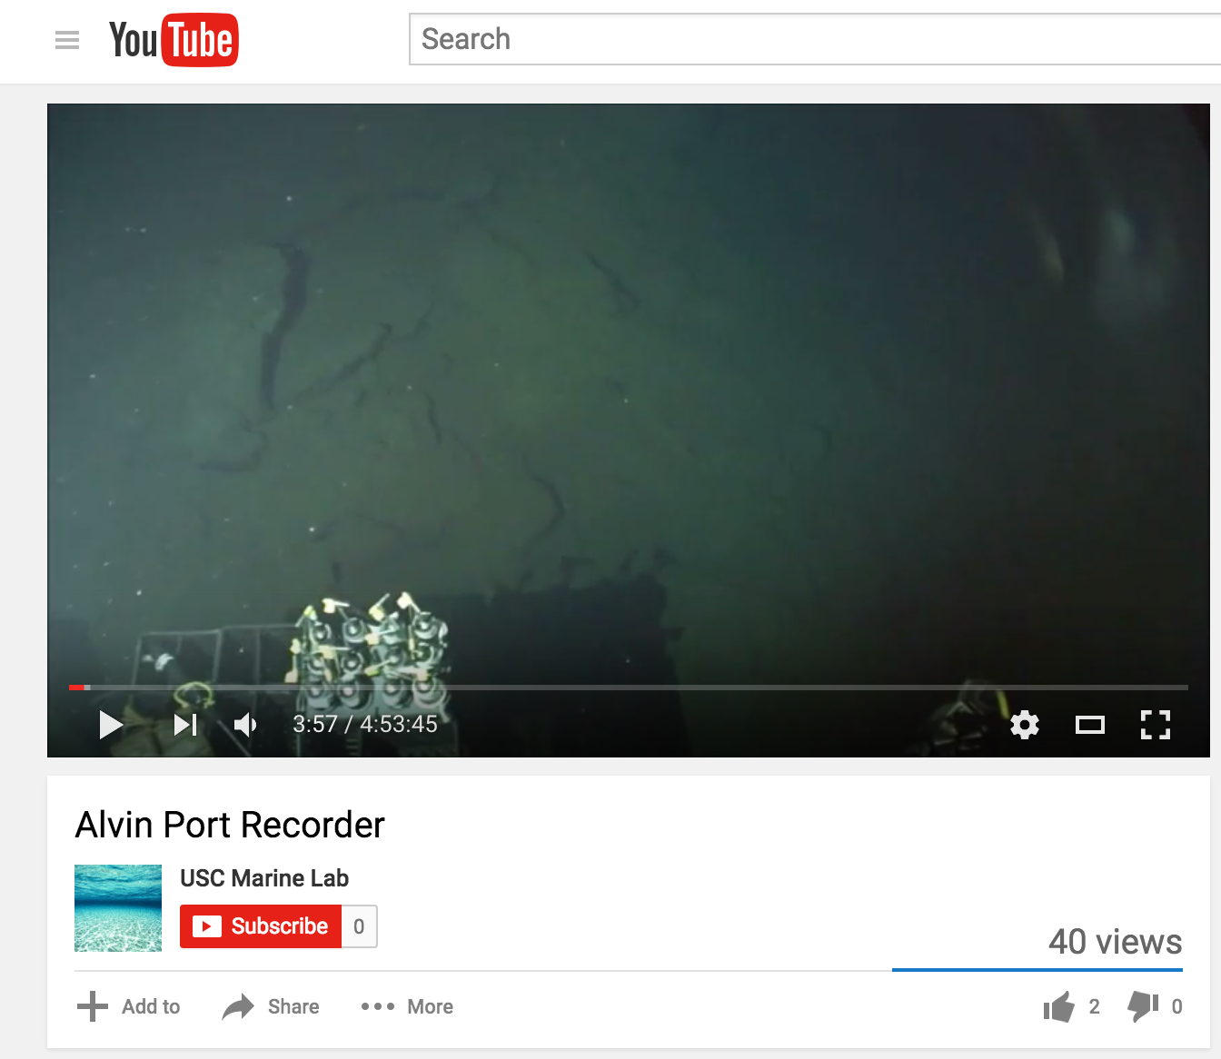
Export Annotations to GIS (Shapefile)

Slide 9
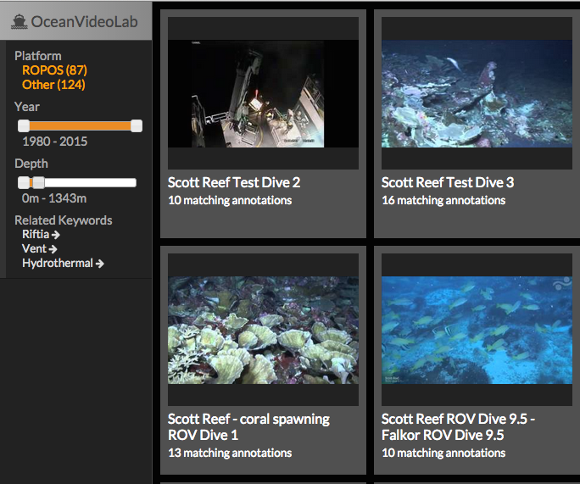
OVL –Next Steps
2016
Beta Testers
Develop & Deploy API
Search Interface
Enhance access to related data (plots, map overlays, etc)
Expand code for Nav input/integration
Extract FrameGrabs?
Beyond 2016…?
Detailed tagging within frame
Crowd-sourcing annotations
Integration of tags/imagery with distributed data ?
Expand to Vimeo ?
Code-share with complementary efforts (e.g. Squidle)
Machine Learning & Big Data

